Slide 1
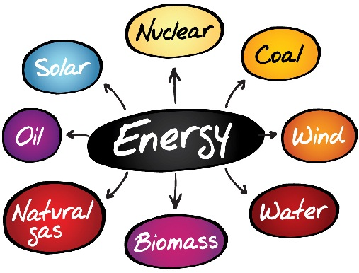

Global Energy consumption over the years Renewable vs Non-Renewable

Slide 2
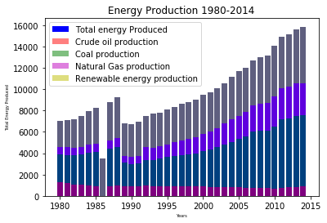
Total Energy Production split up (1980-2014)

Slide 3
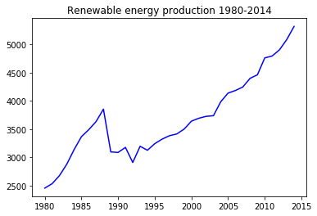
Renewable energy trend

Slide 4
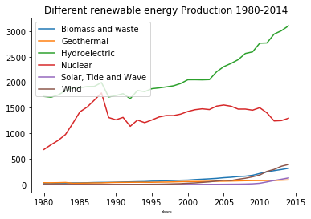
Types of renewable energy production

Slide 5
Going Further:
Show how each country derives energy from different forms
Project the energy production rate for the next decade
Project the energy demands for the same period
Explore the growth potential of the renewable sources to bridge this gap

